Slide 1

CS361: Computer Architecture
Cache: A deep Dive
Instrcutor:Waheed Ahmad
Week 7 Lec 2: Memory
Reading Sections: : Computer Organization & Design: HW/SW Interface, 5th Edition: Section 5.1
Computer Architecture: A Quantitative Approach, Sixth Edition, Section 2.1
CS324 Computer Architecture 1

Slide 2
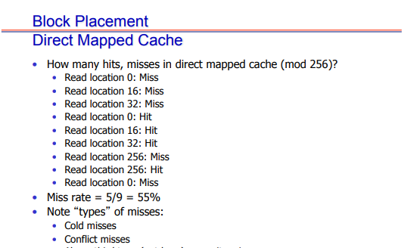

Slide 3
Class Practice
Address of Reference | Assigned Cache Block | Hit or Miss
10101
11001
10101
00101
10001
10101

Slide 4
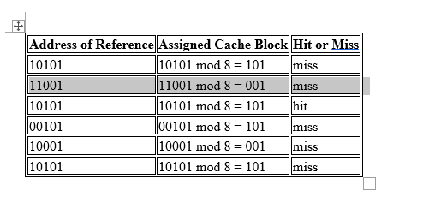

Slide 5
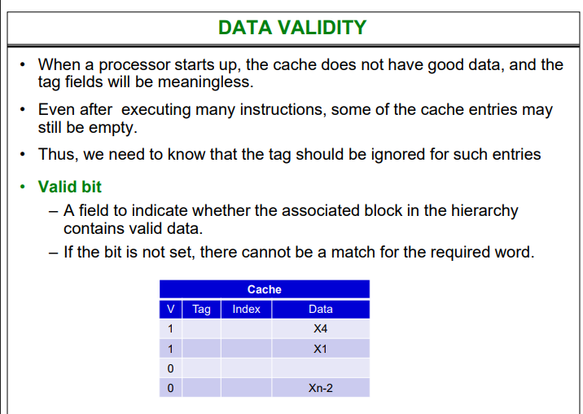

Slide 6
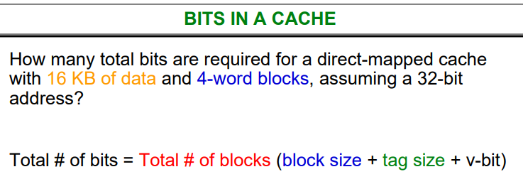

Slide 7
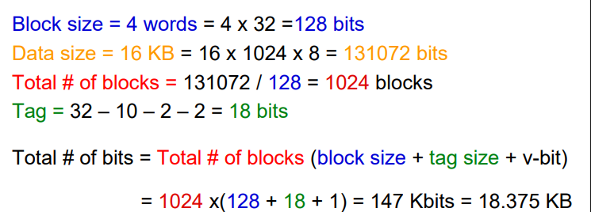

Slide 8
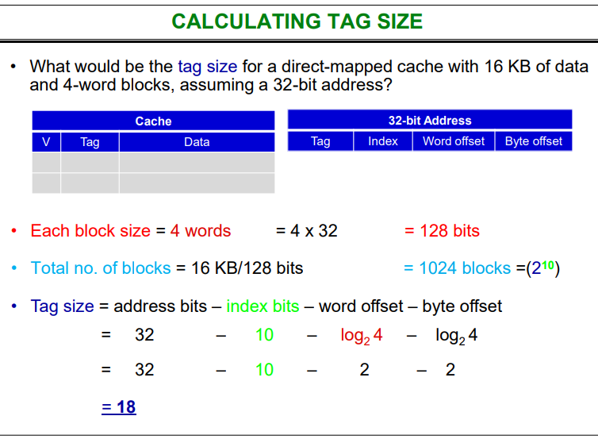

Slide 9

Activity

